Slide 1
DIP PROJECT:
A Morphological Hessian Based Approach for Retinal Blood Vessels Segmentation and Denoising Using Region-Based Otsu Thresholding
Team Members:
Abhayram A Nair (2019102017), Btech. ECE
Aravind Narayanan (2019102014), Btech. ECE
Hemant Suresh (2019102016), Btech. ECE
Prayushi Mathur (2021701034), MS
Mentor:
Sai Manaswini Reddy Indupuru
Team: Society
Github: https://github.com/Digital-Image-Processing-IIITH/dip-project-society

Slide 2
Goals and Objectives
The aim of this project is to find a less computational unsupervised automated technique with promising results for the detection of retinal vasculature by using a morphological hessian-based approach and region-based Otsu thresholding.
Obtaining vessel segmentation results by applying the proposed method.
Analyzing the results using 4 performance criterion and computing an average value over 20 test images.

Slide 3
Dataset
STARE(STructured Analysis of the Retina) dataset:
A full set of ~400 raw images in the STARE database.
Blood vessel segmentation work included 40 labeled images
We have used 20 images to perform the analysis.
Reference Link: https://cecas.clemson.edu/~ahoover/stare/

Slide 4
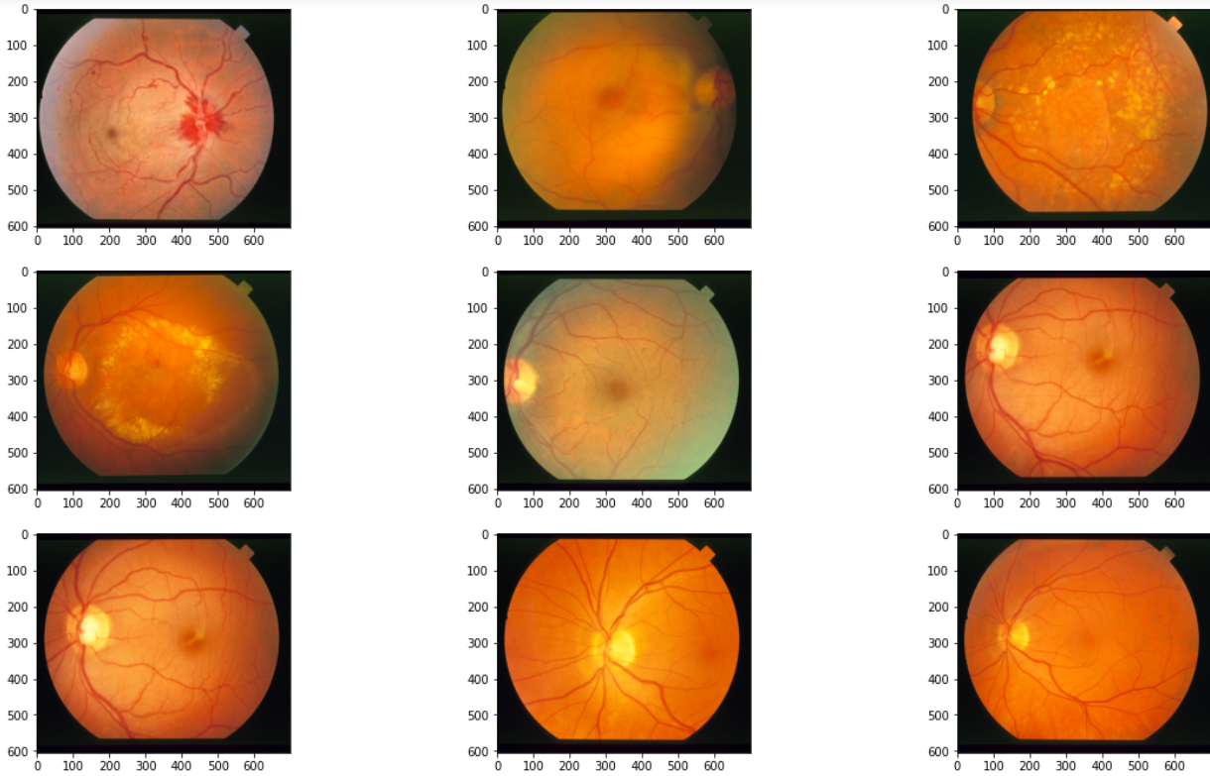
Sample Input Images

Slide 5
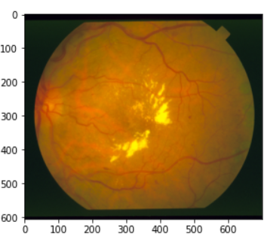
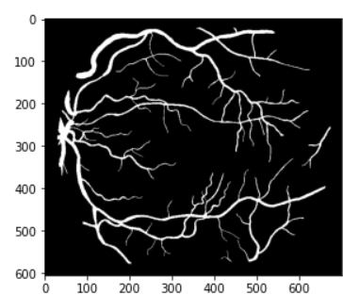
Image pairs
Hand labeled vessel network provided by Valentina Kouznetsova
Input Image

Slide 6
PREPROCESSING

Slide 7
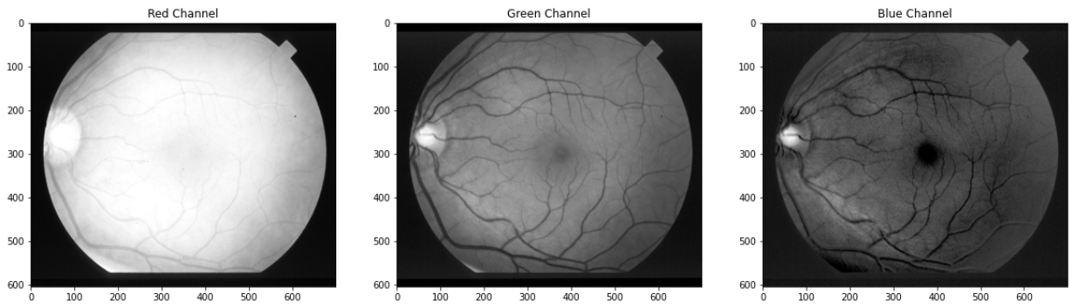
Step-1) RGB splitting

Slide 8
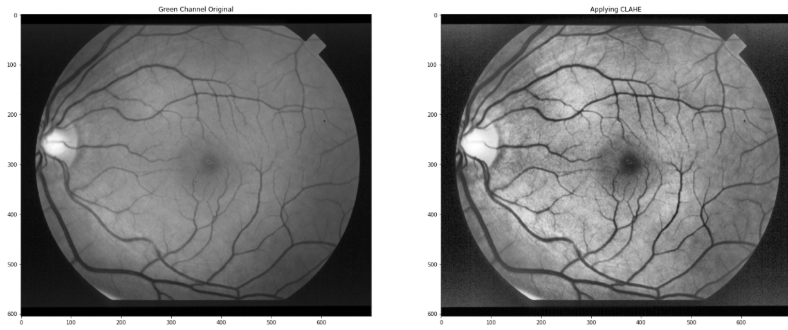
Step-2) G channel-> CLAHE

Slide 9
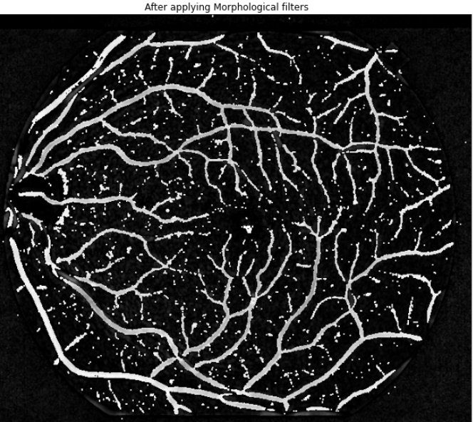
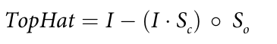
Step-3) Morphological filter
Modified Top Hat transform with a circular structuring element:
Erosion

Slide 10
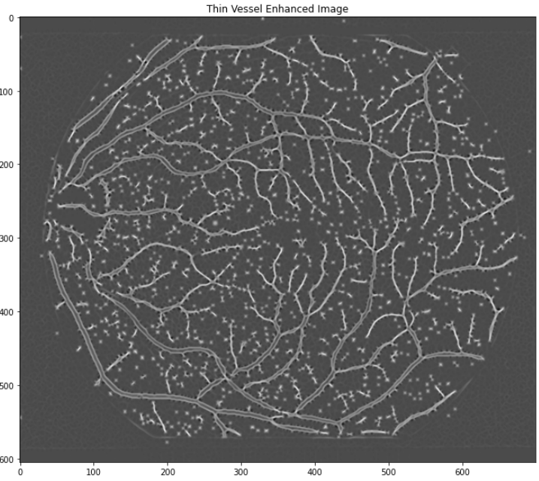
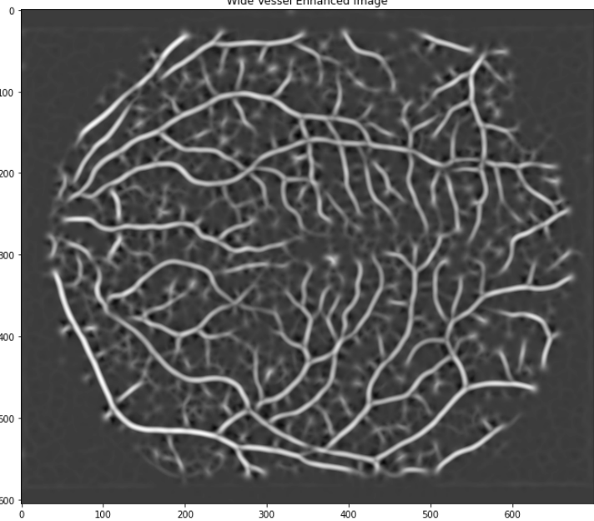
Step-4) Hessian Matrix

Slide 11
SEGMENTATION

Slide 12
Step-5)
Applying global otsu thresholding on wide vessels enhanced image to obtain global thresholding wide vessels output image.
Image fusion of the global thresholded wide vessels output image and thin vessels enhanced image.
Applying local Otsu thresholding on fused image.

Slide 13
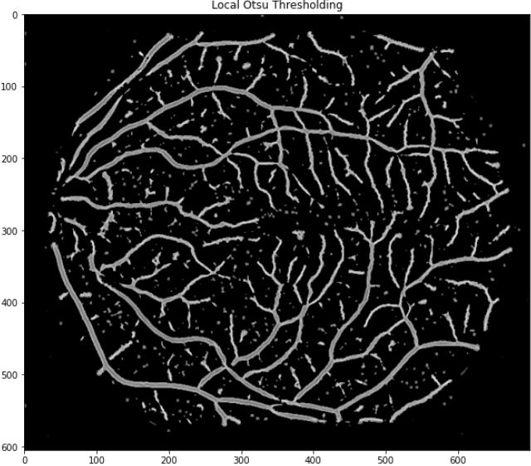
Local Otsu thresholded image

Slide 14
POST PROCESSING

Slide 15
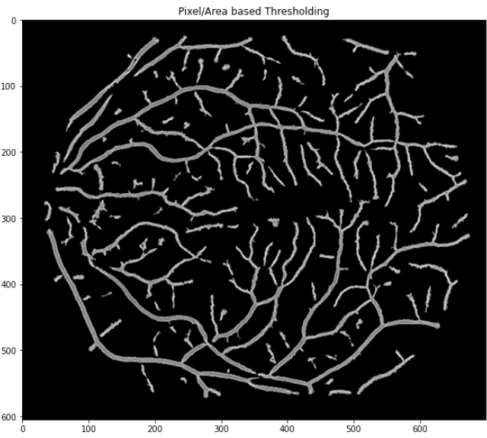
Step-6) Final output: Pixel/area based thresholding

Slide 16
Graphical User Interface built for the project

Slide 17
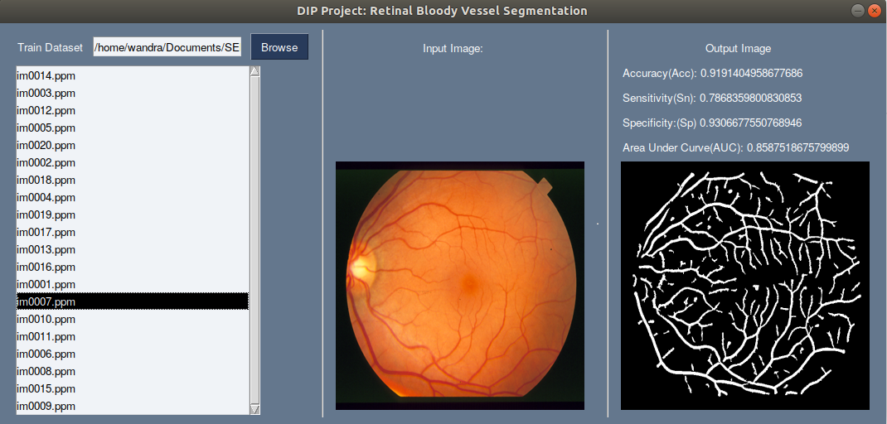
GUI
Features of GUI:
Ability to select the image to be sent for Segmentation from the file manager.
Ability to view the input and output image.
Displays the performance of the image when compared with its ground truth image.
Framework used: PySimpleGUI, Tkinter

Slide 18
Performance Analysis

Slide 19
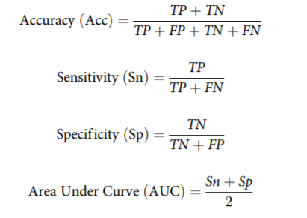
Accuracy Metrics
Four commonly used parameters to compare the performance are used
Accuracy: shows the overall segmentation performance.
Sensitivity: indicates effectiveness in detection of pixels with positive values
Specificity: measure the detection of pixels with negative values.
Area Under the Curve: the area under a Receiver Operating Characteristic (ROC) curve

Slide 20
Observations based on our implementation
Image No. | Acc | Sn | Sp | AUC
1 | 0.9155 | 0.7221 | 0.9322 | 0.8272
2 | 0.9427 | 0.7166 | 0.9588 | 0.8377
3 | 0.8910 | 0.8230 | 0.8953 | 0.8591
4 | 0.9481 | 0.6817 | 0.9695 | 0.8256
5 | 0.8996 | 0.7674 | 0.9127 | 0.8401
6 | 0.9174 | 0.8034 | 0.9260 | 0.8647
7 | 0.9191 | 0.7868 | 0.9306 | 0.8587
8 | 0.9365 | 0.8259 | 0.9454 | 0.8857
9 | 0.9273 | 0.7483 | 0.9426 | 0.8454
10 | 0.9058 | 0.7819 | 0.9167 | 0.8493
11 | 0.9288 | 0.7846 | 0.9398 | 0.8622
12 | 0.9335 | 0.8282 | 0.9423 | 0.8853
13 | 0.9324 | 0.7514 | 0.9501 | 0.8507
14 | 0.9329 | 0.7532 | 0.9508 | 0.8520
15 | 0.9396 | 0.7200 | 0.9603 | 0.8402
16 | 0.9391 | 0.6819 | 0.9684 | 0.8251
17 | 0.9398 | 0.7798 | 0.9555 | 0.8676
18 | 0.9668 | 0.7012 | 0.9810 | 0.8411
19 | 0.9508 | 0.7435 | 0.9601 | 0.8518
20 | 0.9352 | 0.7001 | 0.9520 | 0.8260
Average | 0.930095 | 0.75505 | 0.944505 | 0.849775

Slide 21
Division of Labour

Slide 22
Division of Labour
Abhayram A Nair:
Segmentation, Posprocessing and Documentation
Aravind Narayanan:
GUI, demo, channel splitting, CLAHE and morphological filtering
Hemant Suresh:
Hessian matrix and Eigenvalues approach for Wide and Thin vessel enhanced image
Prayushi Mathur:
GUI ,Presentation, Documentation

Slide 23
THANK YOU

